Slide 1

Website requirements

Slide 2
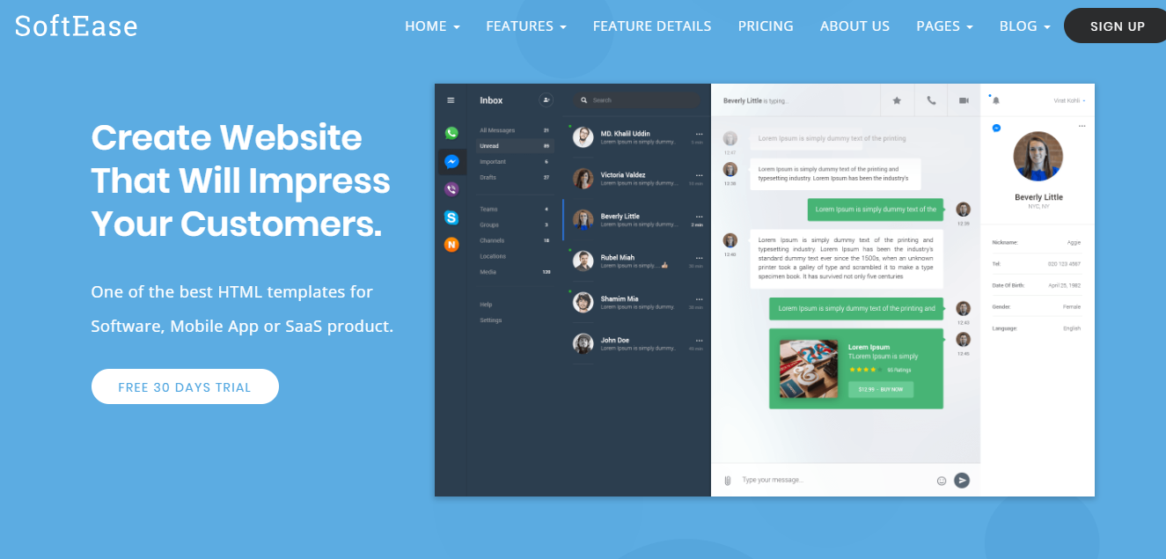
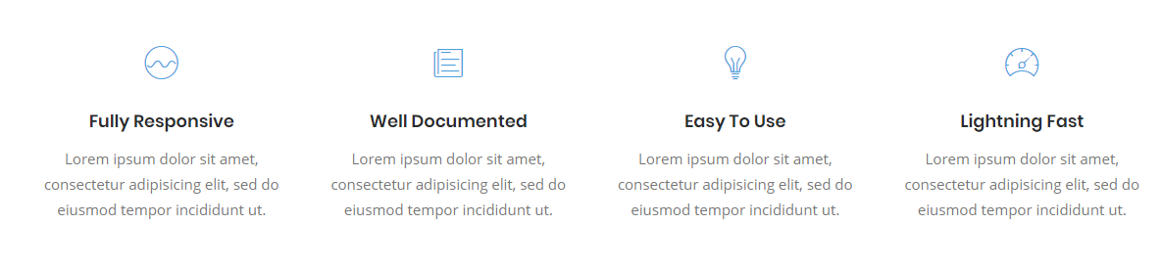
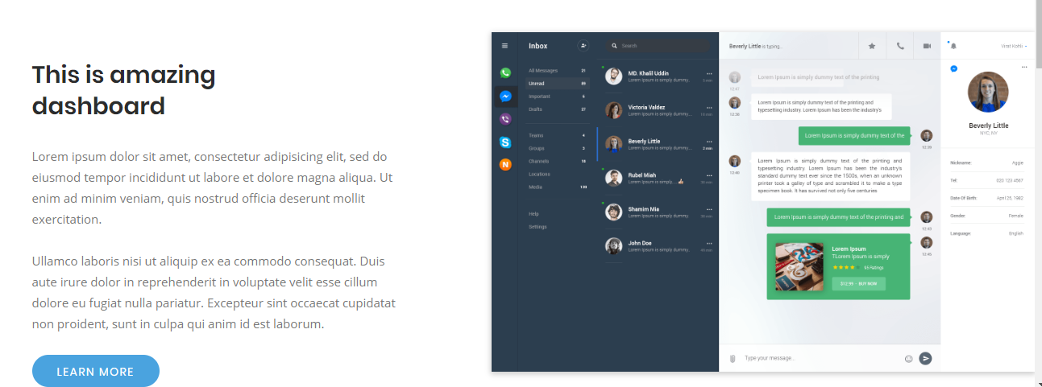


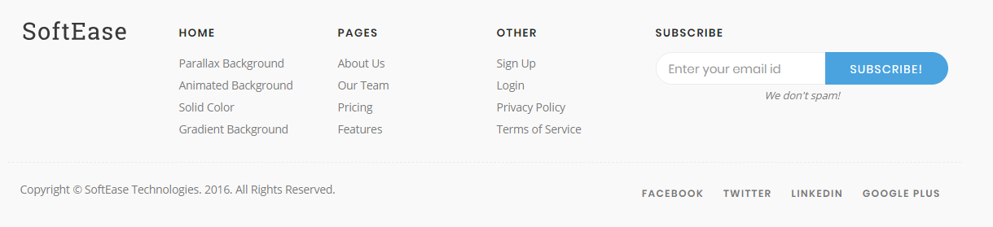
Elements to use from the theme
http://demo.themesease.com/SoftEase/index-simple.html
http://demo.themesease.com/SoftEase/index-simple.html
With animated gif on the right, without animated background, with white header
Icon list
Test on left with call to action, and animated pic on right (or static pic)
Steps 1 – 2 3
Call to action
footer
Pricing page
Blog
http://demo.themesease.com/SoftEase/pricing.html
http://demo.themesease.com/SoftEase/blog-left-sidebar.html
http://demo.themesease.com/SoftEase/blog-single-left-sidebar.html

Slide 3
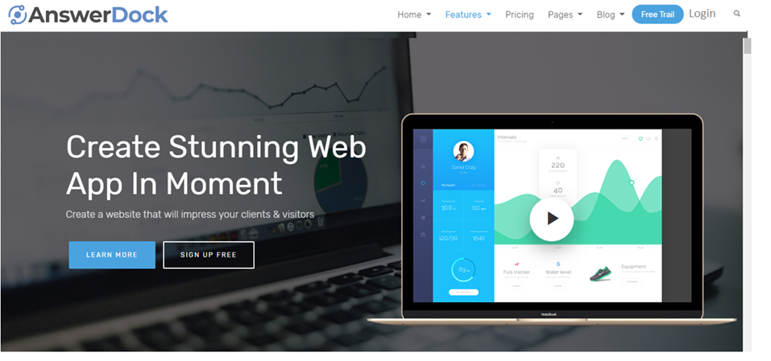
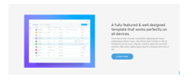
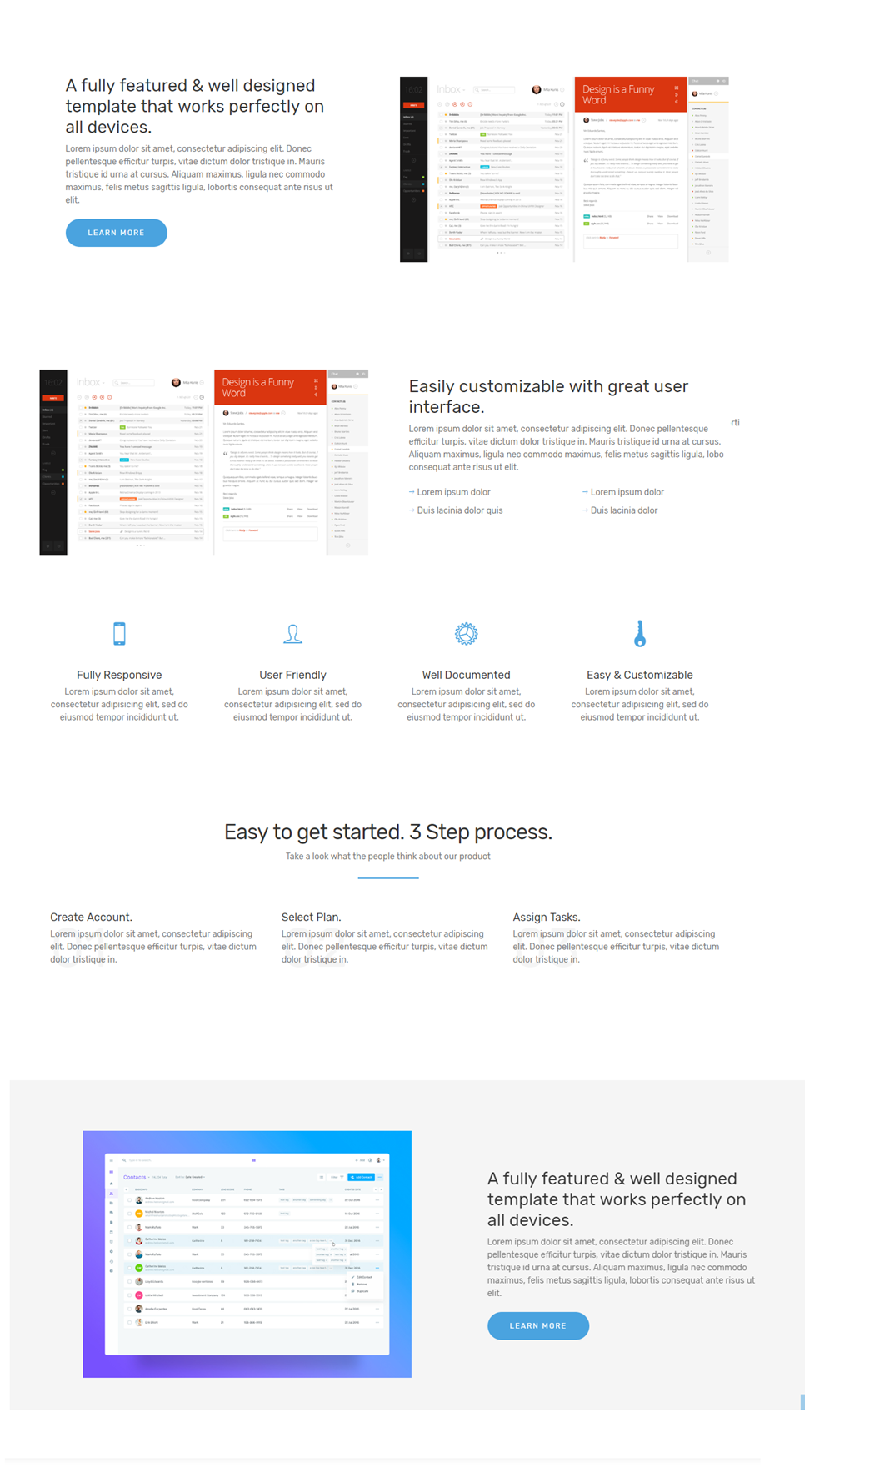

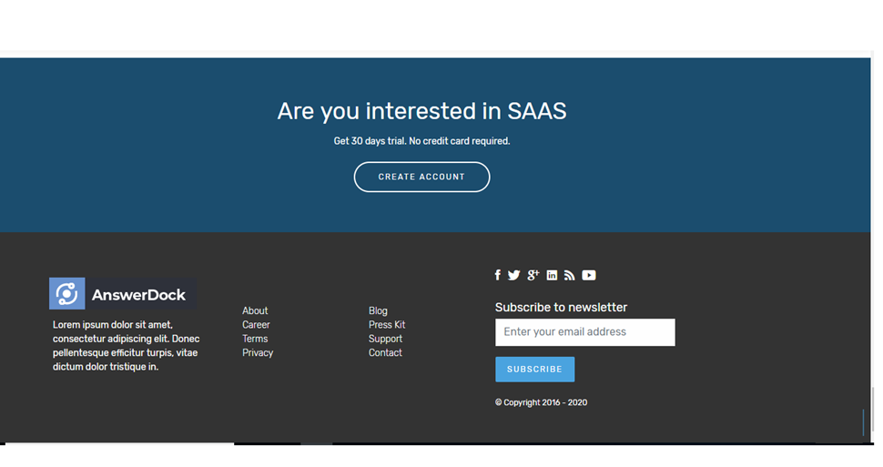
Homepage
Connect your data, ask questions in English and get instant answers
With AnswerDock, business users have access to a self-service tool that provides instant answers to their day to day business questions allowing them to make better and faster data-driven decisions.
http://demo.themesease.com/SoftEase/index-simple.html
With animated gif on the right, without animated background, with white header
Answerdockdifference.gif
The Answerdock Difference: Made for business users
Other analytics tools
Data analysts to build and deploy curated reports for business users to consume, through time consuming tools with layers of command menus
Answerdock, business users themselves start typing their questions, just like using a web search engine. AnswerDock runs the analysis and displays the optimal visualization instantly, its that simple.
Learn more (link to features page)
Beyond the basics, Understand the “why” behind an insight
Understandthewhy.gif
Answerdock leverages powerful prediction and insights discovery algorithims to answer questions such as
What drives my conversion rate up
Why did revenue peak yesterday
Whats driving shipment status to be delayed
Learn more (link to features page)
industries
You got data? Then Answerdock works for your industry
Answerdock is built to work with any dataset. Industry professionals from any business function can use Answerdock to easily explore and find insights on the fly
Learn more
Easy
Instant
Works on any data
Safe, secure, scalable.
Ask questions in English though a search-like web interface, guided by autocomplete suggestions
Generates Answers instantly as you type your question, no waiting for data analysts to create reports for you
Answerdock connects to your company’s data connectors from plain excel files, to relational databases and third party APIs such as google analytics
Secure and scalable cloud storage
Get started in 4 easy steps
Connecting your data is easy and straightforward
Connect to Data source
Prepare your data
Schedule load
Start exploring
Choose data type, and authenticate access to your Data
Answerdock automatically understands your schema and data model, but you can optionally provide more information
Easy
Define how to regularly fetch and update your data to keep it up to date
Once Answerdock uploads and indexes your data, you can start exploring right away
Try AnswerDock on your data
30-day Free trial , no credit cards required
Free trial
Answer dock is a data analytics company that uses natural language processing (NLP) coupled with AI capabilities to empower business users to make smarter dcisions, through easy data explorations and insight discovery
About
Product Overview
Industries
Contact us
Blog
Product documentation
Fb,twitter,linkedin
2018

Slide 4
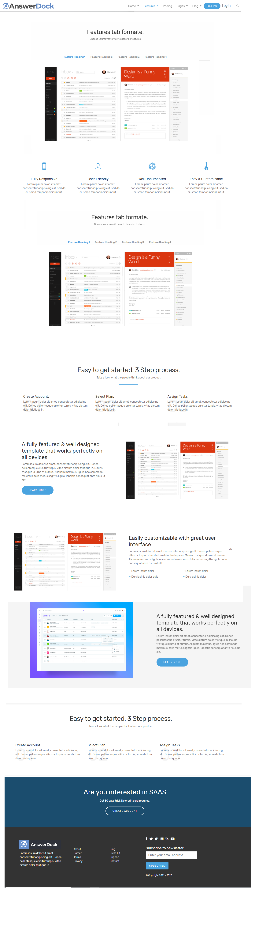

Analyze your data in seconds using Answerdock’s Ai-driven, Natural Language Processing Engine
Product - features
All you have to do is ask
AI-driven and guided Search
Instant Answers
Interactive charts
Dashboards
<
>
Machine learning algorithims provide suggestions based on your data model and search history
Ask anything in plain English and get instant answers while typing with the best fit visualization displayed
Choose from an interactive and highly customizable set of visualizations
Save your charts separately or build and schedule dashboards with a few clicks
Fast
secure
Highly customizable
100% accurate
Answerdock indexes data on the cloud to optimize for quick data retrieval, real time granular computations
Secure cloud connection coupled with enterprise wide data governance
You can teach Answerdock your company’s jargon to enable users to more easily analyze and discover insights
Answerdock provides the detailed criteria and word by word interpretation of your question so you know how the answer is calculated
Go beyond basic analytics
Discover and understand peaks and dips
Understand the why, discover trends, all starting with a simple quesiton
Undestand correlations
Discover trends
Drill through, and show underlying data
<
>
Curious about the dip in revenue this month? Simply ask why
Want to understand relations between your metrics?
Answerdock helps you discover trends and generate actionable insights
Drill through your answer for a more granular look / OR GROWTH
Link Answerdock to any kind of data
Flat Files
15+ data connectors and more to come..
Upload csv or excel files and start analyzing your data immediately
Relational Databases
3rd party APIs and cloud apps
Connect to Mysql, Sql Server, Maria DB and other relational databases, with frequent data loads to ensure your data is always fresh
Connect to 3rd party APIs and have all your data from differnet Apis accessible in one place
You got data? Answerdock works for your industry
You got data? Answerdock works for your industry
Get started in 3 easy steps
Connecting your data is easy and straightforward
Connect to Data source
Prepare your data
Start exploring
Choose data type, and authenticate access to your Data
You can provide Answerdock a bit more information about some columns in your data
Easy
Once Answerdock uploads and indexes your data, you can start exploring right away
Start your Free trial right away
Instant access to trial version, No credit card required
Free trial

Slide 5
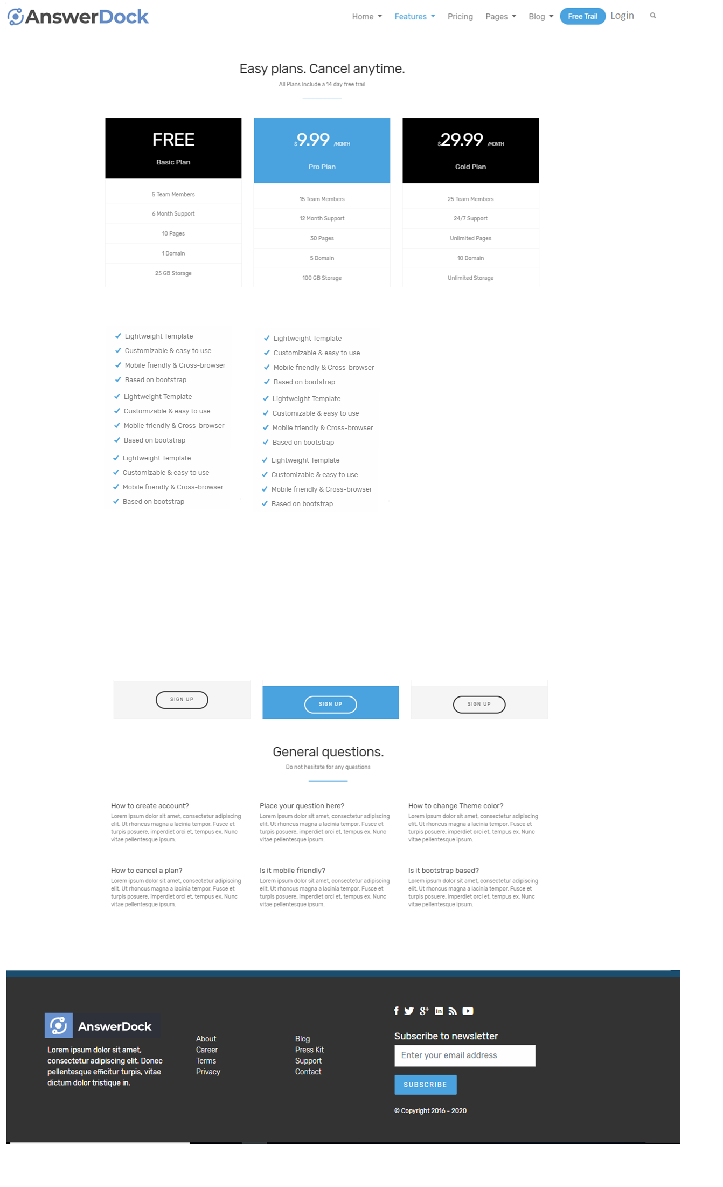
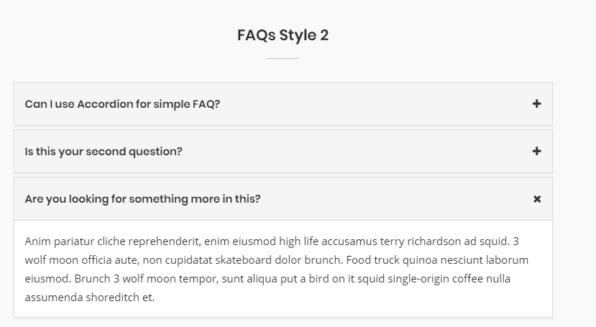
Subscription plans
Product - pricing
Scalable and customizable according to your needs
One month Free trial
Enterprise
Customized plan
1 user
Starting from 5 users
Need more? Contact us to customize your plan
1 dataset
50 Datasets
10 mb file upload
100 mb file upload
100k rows limit
100m rows limit per dataset
15 columns limit
50 columns limit
10 mb cloud storage
Scalable storage starting with 10 GB
Csv and excel upload
All available data connectors
Simple, easy and guided search
Customizable column synonyms for easy searching
Automatic optimal chart selection
25+ customizable charts
Chart export to pdf, xls and png
Analysis explanation
Automatic data indexing for fast search
Saved Questions
Dashboards
Data mining algorithims (regression, decision rules)
Product guide and documentation
All features of free trial , plus
Company wide permissions module
Automated Alerts
Scheduled Dashboards
High speed data loading up to hourly frequency and 5 concurrent loading jobs
Signup
Contact us
Contact us
Can I upgrade later to increase users or storage capacity?
Frequently asked questions
Do you have an on premise solution
How and where will you store my data ?
At AnswerDock we are passionate about the cloud. We currently do not offer any on-premise solution. Your data can still be on premise but AnswerDock will load it periodically to our cloud storage. From our experience querying on-premise data directly is not optimal, as it does not offer the same performance as cached and indexed data hosted on our cloud
Yes, similar to any cloud hosting solution like AWS or Azure or Google cloud, you can upgrade your storage or add new users as per your needs
Your data will be stored and secured on AnswerDock’s cloud storage. This enables us to cache and index your data to guarantee fast search and data retrieval
What data connectors do you support
How will my data stay up to date?
Currently we support CSV, Excel, Mysql,SQL server,Marioa DB, Amazon redshift
If your data is from a CSV or Excel File, you can upload additional files as frequent as you need
If your data is linked to a DB server like mysql or sql server, you will be able to define periodic jobs to retrieve your data at specific intervals and keep it up to date

Slide 6
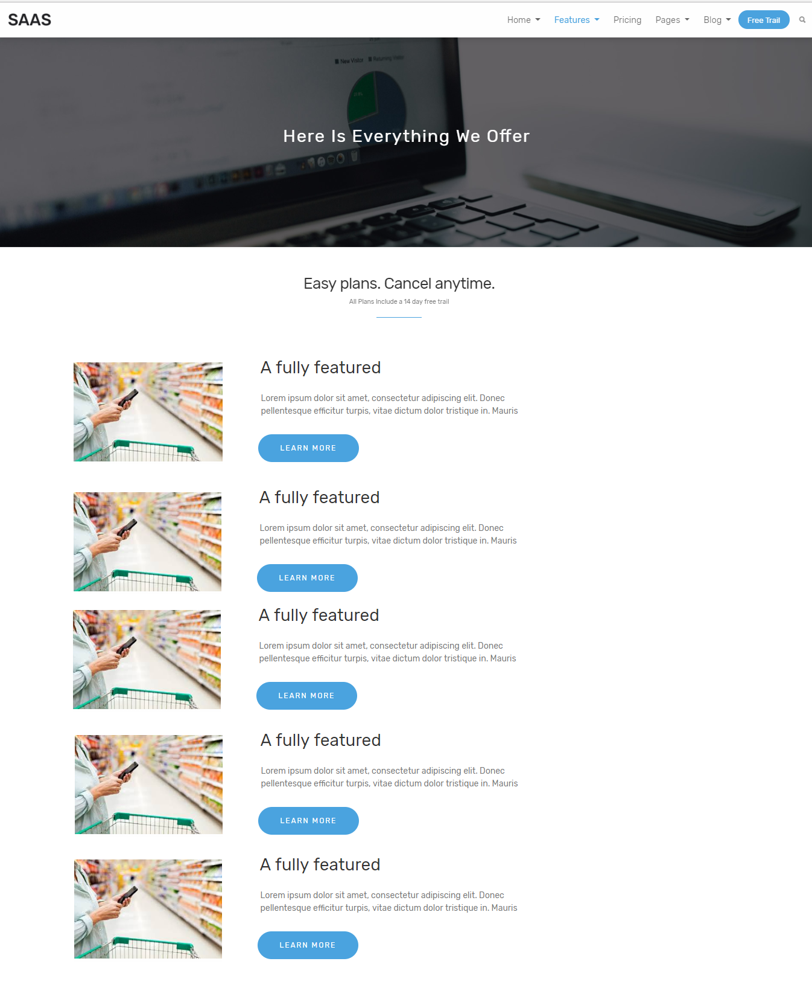


Solutions - overview
See how AnswerDock can work for your industry
Industry professionals from any business function can use Answerdock to easily explore and find insights from their company data on the fly, using a simple and intuitive interface and no required training
Retail, Ecommerce and CPG
Understand and compare performance across segments , analyze customer cohorts, find shopping trends and analyze anomalies in consumer behavior
Financial Services and insurance
Review your outstanding mortgages, analyze customer claims by product and region, and gain deeper understanding on your securities returns
Healthcare
Review patient wait times, room turnover, insurance claims, treatment charges and patient satisfaction
Communications
Understand subscribers behavior, compare performance across products and regions and analyze customer satisfaction
Transportation and logistics
Analyze performance by shipping category, track inventory levels, gain deeper understanding of delivery performance and understand the reasons behind shipping delays
Other industries include:, Legal, Professional Services and Manufacturing
If you have data, AnswerDock can help you analyze it and find insights easily , regardless of your industry.

Slide 7
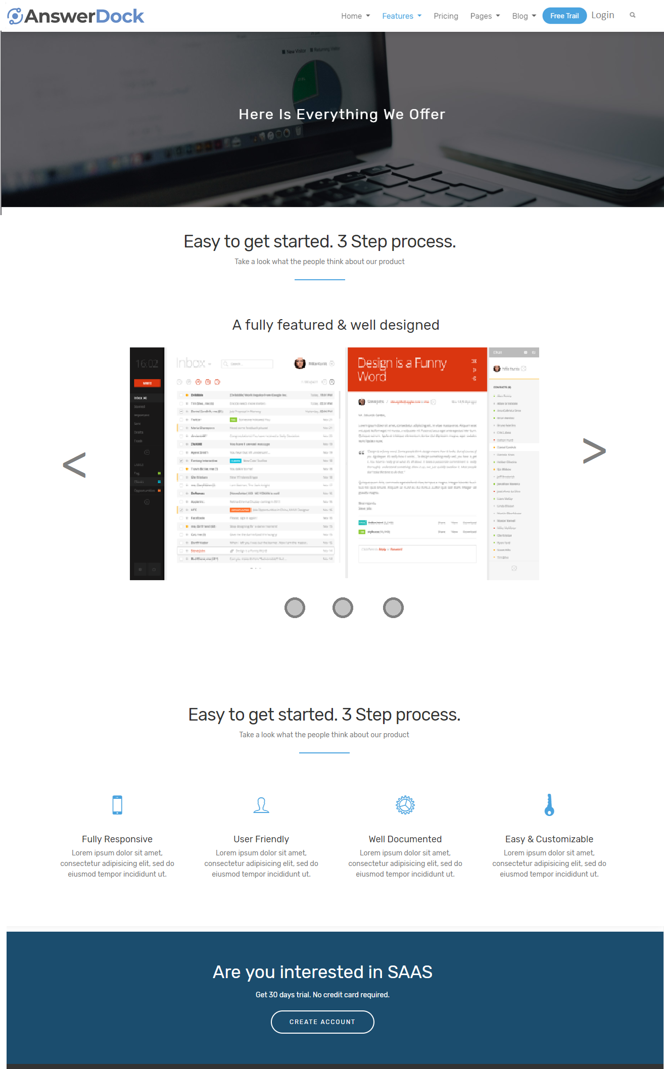
Solution detail page - retail
Answerdock for Retail, e-commerce and CPG
Image title
Will provide 3-4 animated GIFs
Each image with title on top :
1- image1:
2-image2:
3-image3:
4-image4:
Employees from every role can become their own data analysts, getting instant answers to make data-driven decisions
Below are a Few example roles in retial that can use Answerdock
Buyers and category managers
Operations manager
Omni channel marketers
Management
Analyze performance of your categories, brands and customers and discover actionable insights
Get instant visibility on your sales and warehouse inventory levels across thousands of SKUs
Analyze marketing campaigns performance and optimize your spend across channels
Analyze sales and orders volums across categories, products, regions, etc.. and understand peaks and dips in demand

Slide 8
Solution detail page - finance
Answerdock for Finance and Insurance
Through simple questions, you can review your outstanding mortgages, analyze customer claims by product and region, and gain deeper understanding on your securities returns
See how AnswerDock can help financial institutions become fully data-driven
Image title
Will provide 3-4 animated GIFs
Each image with title on top :
1-
2-
3-
4-
Employees from every role can become their own data analysts, getting instant answers to make data-driven decisions
Below are a Few example roles in Finance and Insurance that can use Answerdock.
Sales
Mortgage Brokers
Trading professionals
Management
Capitalize on sales opportunities, understand sales trends and compare performance per customer segments
Understand status of customer loans across the channels mix. Predict segments with higher default probability through simply asking a question
Understand the returns across your securities and spot trends and correlations
Analyze performance across regions, products, customers and teams. Receive dashboards and alerts to your inbox

Slide 9
Solution detail page - finance
Answerdock for Healthcare
Through simple questions, you can review patient wait times, room turnover, treatment charges, drug trial results and patient satisfaction.
See how AnswerDock can help Healthcare institutions become fully data-driven
Image title
Will provide 3-4 animated GIFs
Each image with title on top :
1-
2-
3-
4-
Employees from every role can become their own data analysts, getting instant answers to make data-driven decisions
Below are a few example roles in Healthcare that can use Answerdock.
Facilities managers
Researchers
Management
Analyze patient turnover, increase hospital utilization and decrease wait times by better understanding your performance
Analyze trial results, discover trends and correlations with a simple question
Analyze performance across regions, services and departments. Receive dashboards and alerts to your inbox

Slide 10
Solution detail page - communications
Answerdock for Communications
Understand subscribers behavior, compare performance across products and regions and analyze customer satisfaction
See how AnswerDock can help Healthcare institutions become fully data-driven
Image title
Will provide 3-4 animated GIFs
Each image with title on top :
1-
2-
3-
4-
Employees from every role can become their own data analysts, getting instant answers to make data-driven decisions
Below are a few example roles in Communications that can use Answerdock.
Product Managers
IT
Marketers
Management
Analyze customer segments and lifetime value. Identify top growing products and spot trends to help you tailor your offerings
Analyze error logs and network utilization. Identify usage trends to better plan your infrastructure
Analyze marketing campaigns performance and optimize your spend across channels
Analyze performance across regions, services and departments. Receive dashboards and alerts to your inbox

Slide 11
Solution detail page – transportation and logitcs
Answerdock for Transportation and Logistics
Analyze performance by shipping mode, track inventory levels, gain deeper understanding of delivery performance and understand the reasons behind shipping delays
See how AnswerDock can help Healthcare institutions become fully data-driven
Image title
Will provide 3-4 animated GIFs
Each image with title on top :
1-
2-
3-
4-
Employees from every role can become their own data analysts, getting instant answers to make data-driven decisions
Below are a few example roles in Transportation and Logistics that can use Answer dock.
Product Managers
Operations managers
Warehouse managers
Management
Analyze shipping performance across shipping modes. Better understand shipping costs
Optimize delivery performance by analyzing trends. Use Answerdock to understand the why behind shipping delays
Understand inventory levels and analyze lead times per SKU level to understand and solve bottlenecks
Analyze performance across regions, shipping modes and routes. Receive dashboards and alerts to your inbox

Slide 12
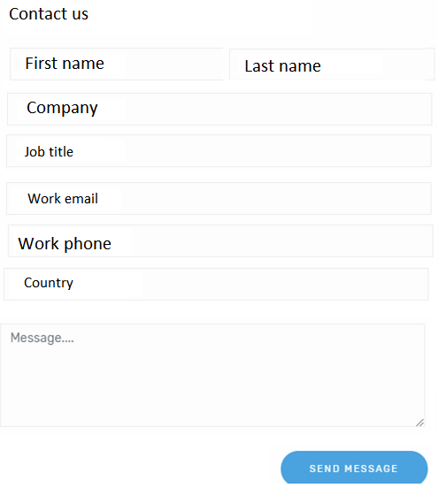
contact us
All fields mandatory except the message
Use contact us form style available in the theme, send the form contents to info@answerdock.com
Drop down country list

Slide 13



About page
About page
Answer dock is a data analytics company that uses natural language processing (NLP) coupled with AI Intelligence (AI) to empower business users to make smarter decisions, through easy data explorations and insight discovery.
Our mission is to create an easy to use analytics product that speaks the business users language and enables them to leverage powerful analysis techniques and algorithms, without the need for data analysts and scientists.
Contact us

